Slide 1
Technical Approach GIST
This PPT demonstrates technical implementation of GIST

Slide 2
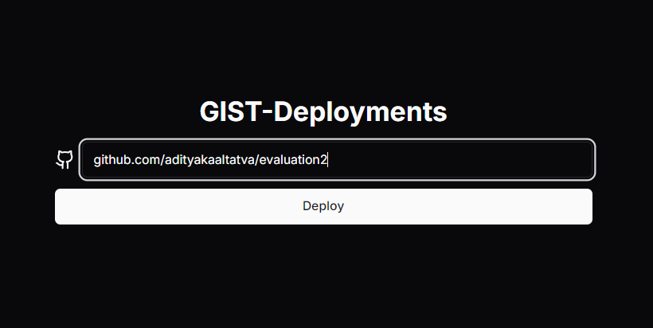

Hit the Endpoint of Github Repositry through our Website It will deploy your Software to production

Slide 3
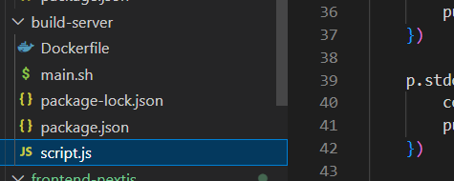
Servers Of GIST
1. Build Server: Build, Upload, Containerize, Generates a Child Process

Slide 4
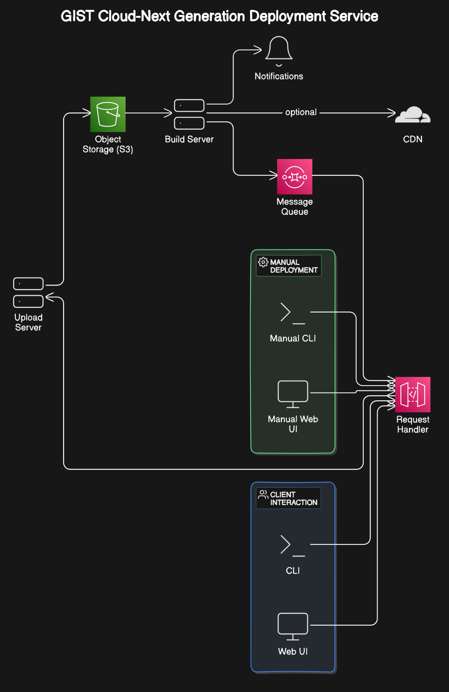
Build Server
Fetch and Clone Github Repositry Files
Containerize them in Individual Conatiners Docker
AWS ECR and AWS ECS for orchestration
Builds the Package Files for Production
Initializes Redis Server locally for Queue Management

Slide 5
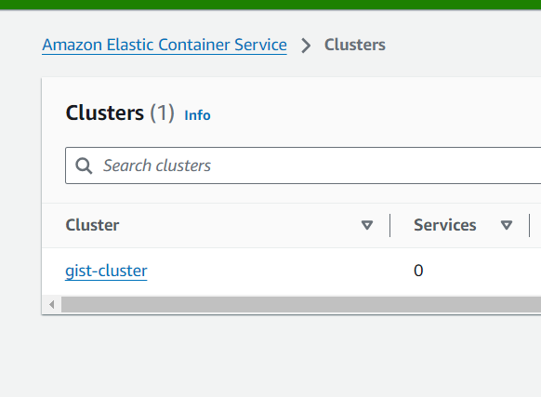
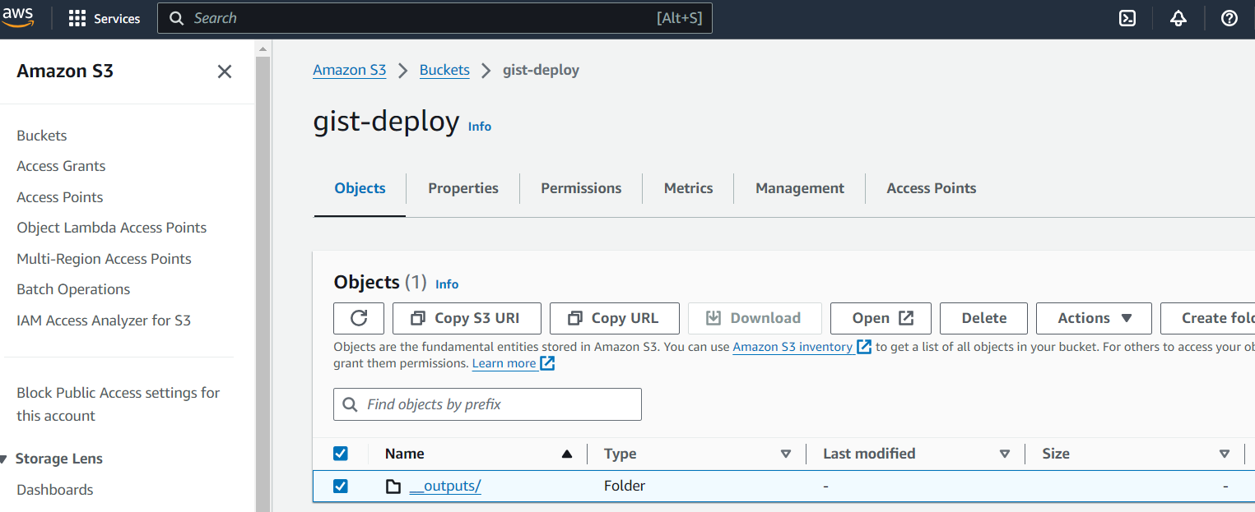
Files Containerized and Uploaded to S3

Slide 6
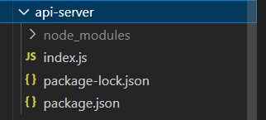
2. API server/Deployment Server
Checks the File for Production
Builds Custom Reverse Proxy through PORT number and S3
Builds an Automated Code process
Builds Pipeline and Integarte it to the Workflow of GIST

Slide 7
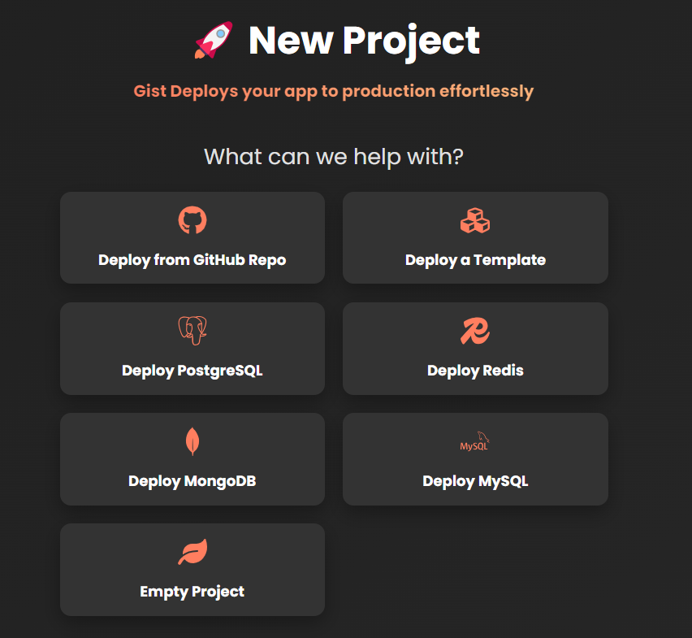
2. Custom Reverse Proxy
Serves Index.html
Builds Custom Reverse Proxy through PORT number and S3
Builds Pipeline and Integarte it to the Workflow of GIST

Slide 8
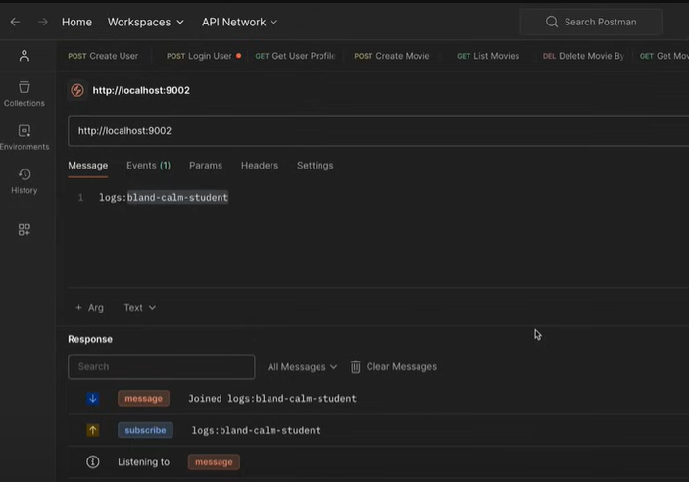
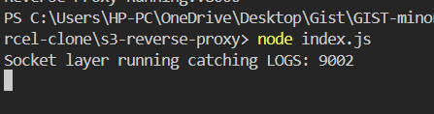
Logs Collection through Socket Layer

Slide 9
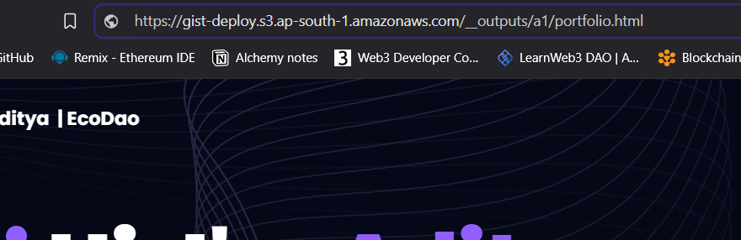
Automatically after Deployment it will redirect to Deployed site through AWS S3 custom proxy request
Site is secured for DOS attacks and session hijacking

